Slide 1
Qu’est-ce que tu as fait pendant les vacances?
Images from pixabay.com
©frenchteacher.net

Slide 2
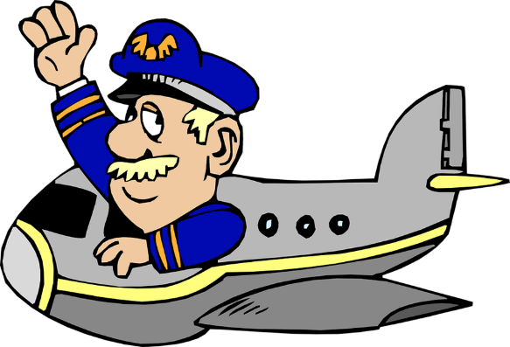

Slide 3


Slide 4
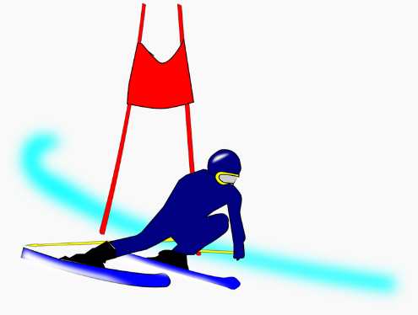

Slide 5


Slide 6
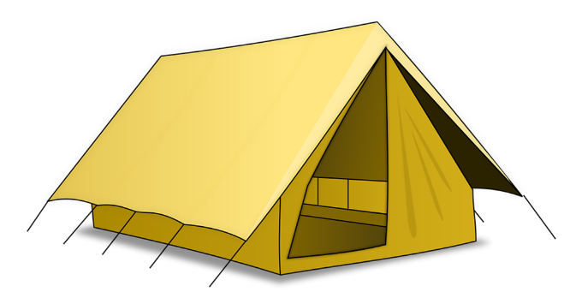

Slide 7
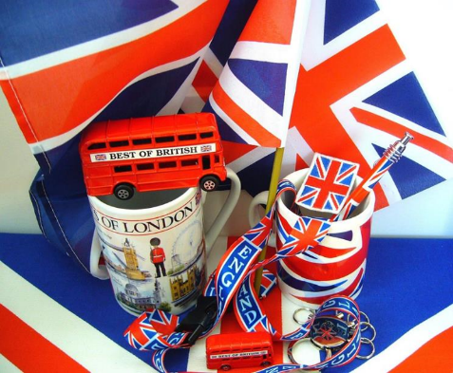

Slide 8


Slide 9


Slide 10
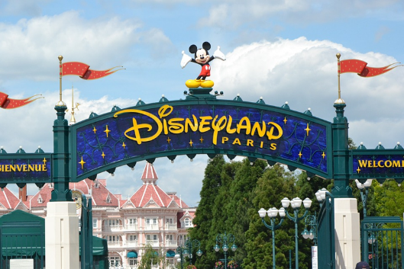

Slide 11
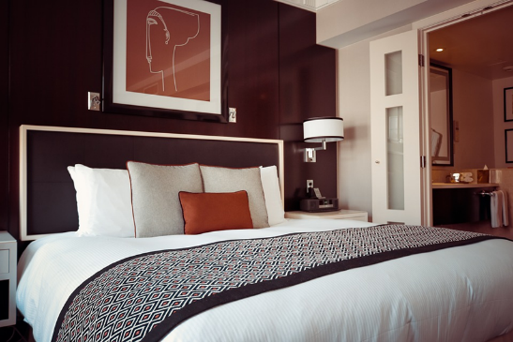

Slide 12
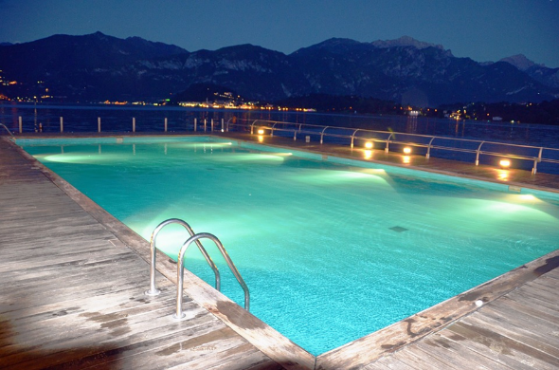

Slide 13


Slide 14

J’ai voyagé en avion

Slide 15

Je suis allé(e) à la plage

Slide 16

J’ai fait du ski

Slide 17
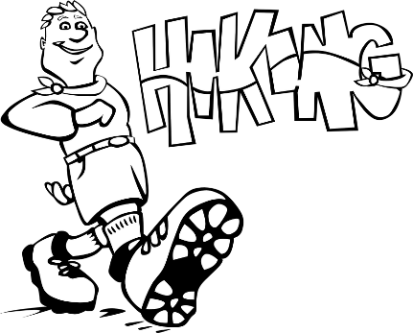
J’ai fait des randonnées

Slide 18

J’ai fait du camping

Slide 19

J’ai acheté des souvenirs

Slide 20

J’ai visité des monuments

Slide 21

Je suis allé(e) au restaurant

Slide 22

Je suis allé(e) à un parc d’attractions

Slide 23
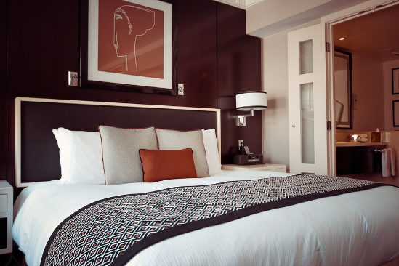
J’ai logé dans un hôtel

Slide 24

Je me suis baigné(e) à la piscine

Slide 25

J’ai partagé des photos avec mes amis

Slide 26






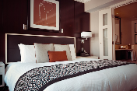






Slide 27
Comment dit-on? How do you say?
I travelled by plane 7. I went to the restaurant
I stayed in a hotel 8. I bought souvenirs
I went camping 9. I swam in the pool
I shared photos with my friends 10. I went to a theme park
I went to the beach 11. I went sightseeing
I went hiking 12. I went skiing

Slide 28
Pairwork guessing game
Write down THREE things you did from the list you have learned.
Your partner must guess what they are by asking yes/no questions
e.g. Tu as voyage en avion?
Tu es allé(e) à la plage?
Tu t’es baigné(e) à la piscine?

Slide 29
Personal challenge
List of as many activities as you can without stopping.
Extension: do the same adding other examples of your own

Slide 30
Variations for the teacher
Go through the slides again using 1st person plural or 3rd singular.
Do a dictation or gap-fill listening activity.
Do another guessing game where pupils make up their own example activities.
Get pupils to write out a mini-essay using/adapting this material.
Provide a text with this language included for intensive input-output work.
Provide a set of short texts recycling this language and some new language.

